Slide 1


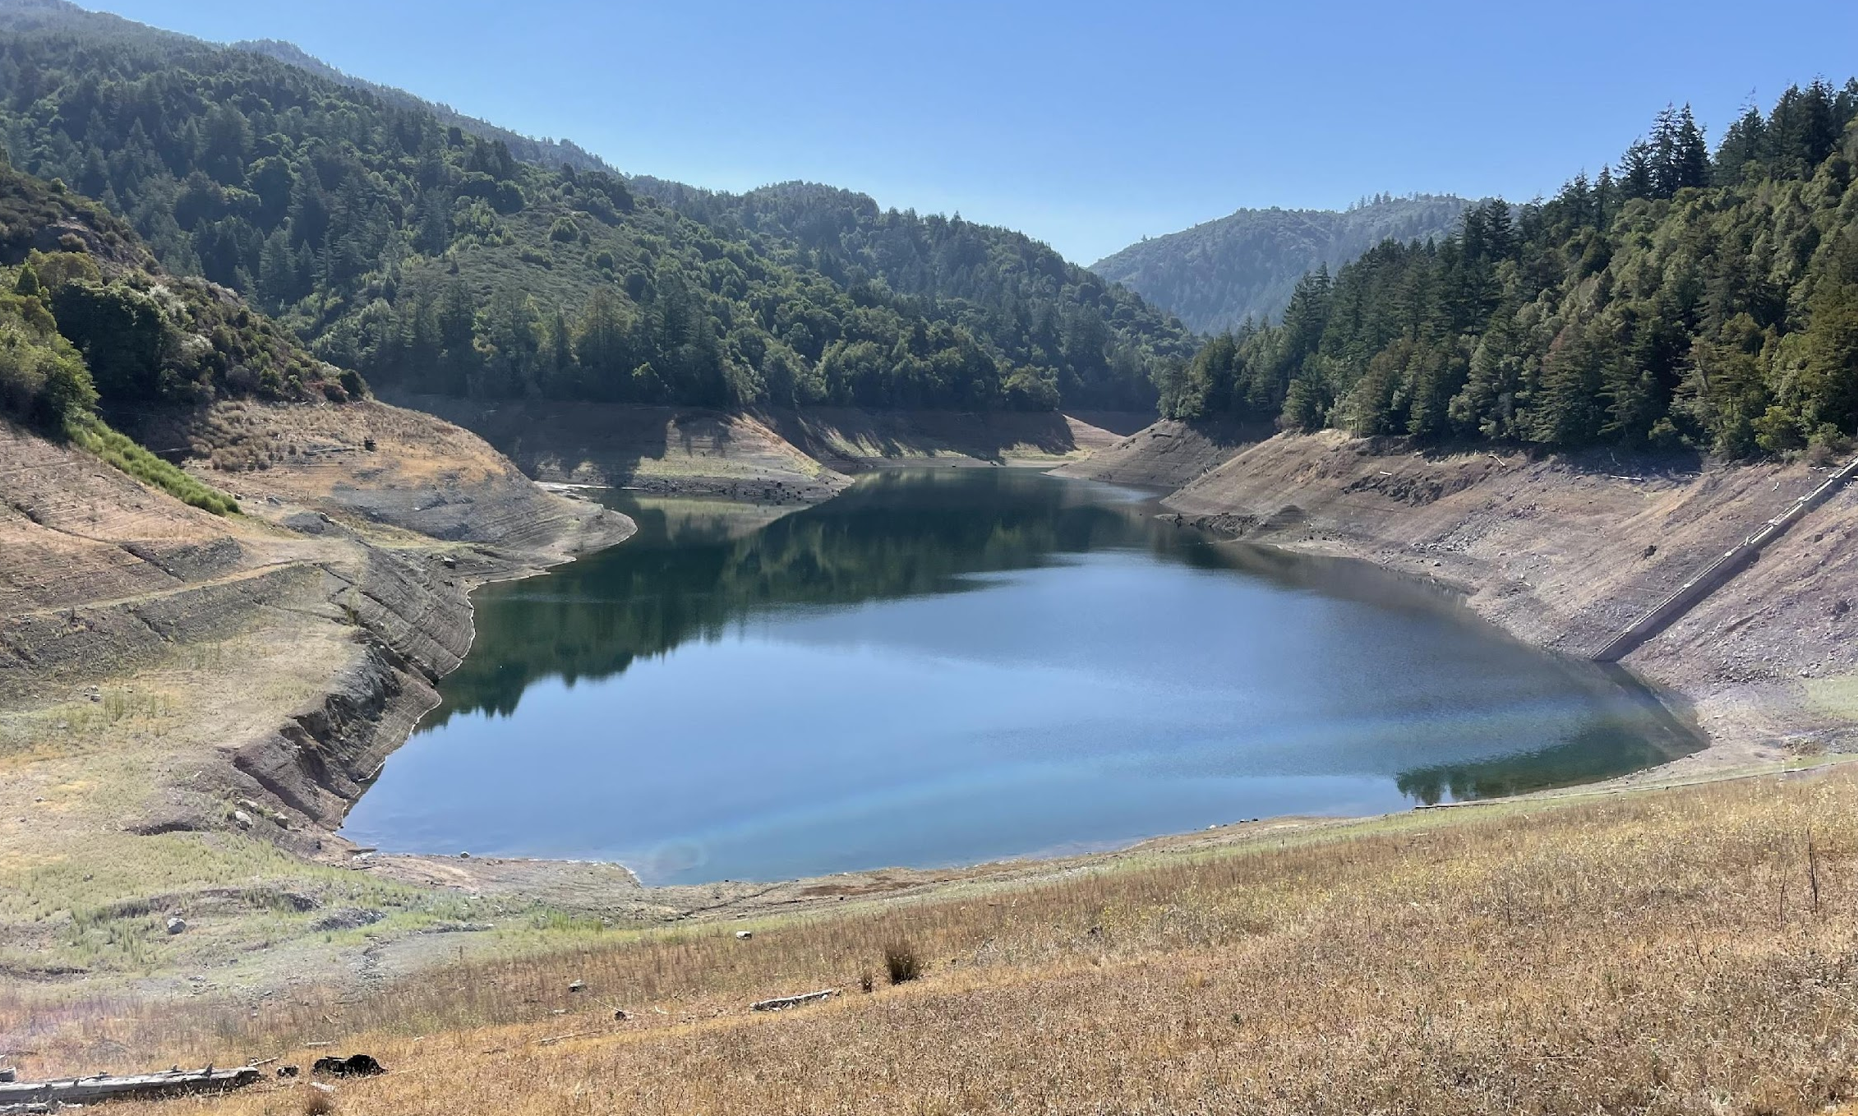

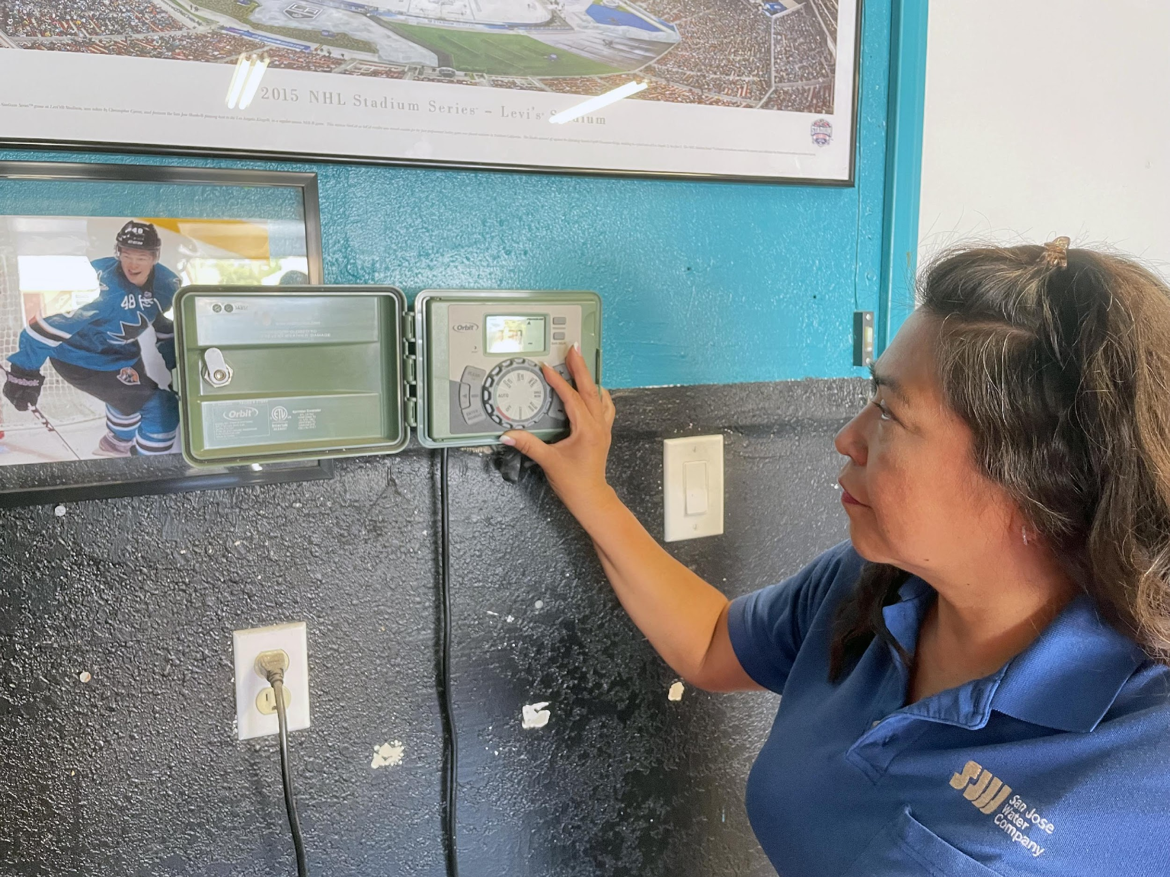
Public Hearing
Mandatory Conservation Plan
Kurt Elvert
Manager of Field Service
and Water Conservation
John Tang
Vice President of Regulatory Affairs
and Government Relations
October 28, 2021

Slide 2
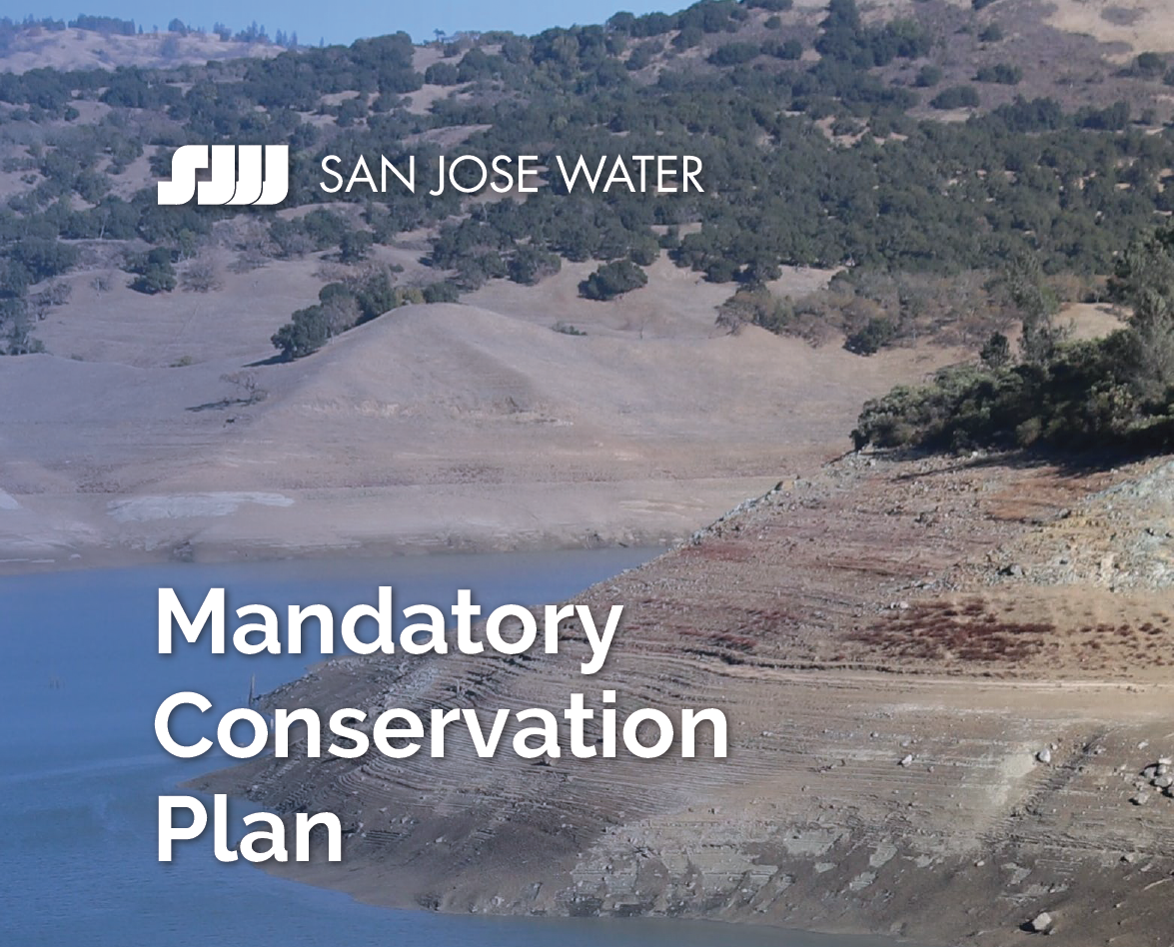
Agenda
Water Supply Status
Conservation Plan
  CPUC Approval
  Plan
  Drought Surcharges
  Allocations
  Appeals
  Questions

Slide 3
Customer Breakdown by Type
199,676
22,253
285

Slide 4
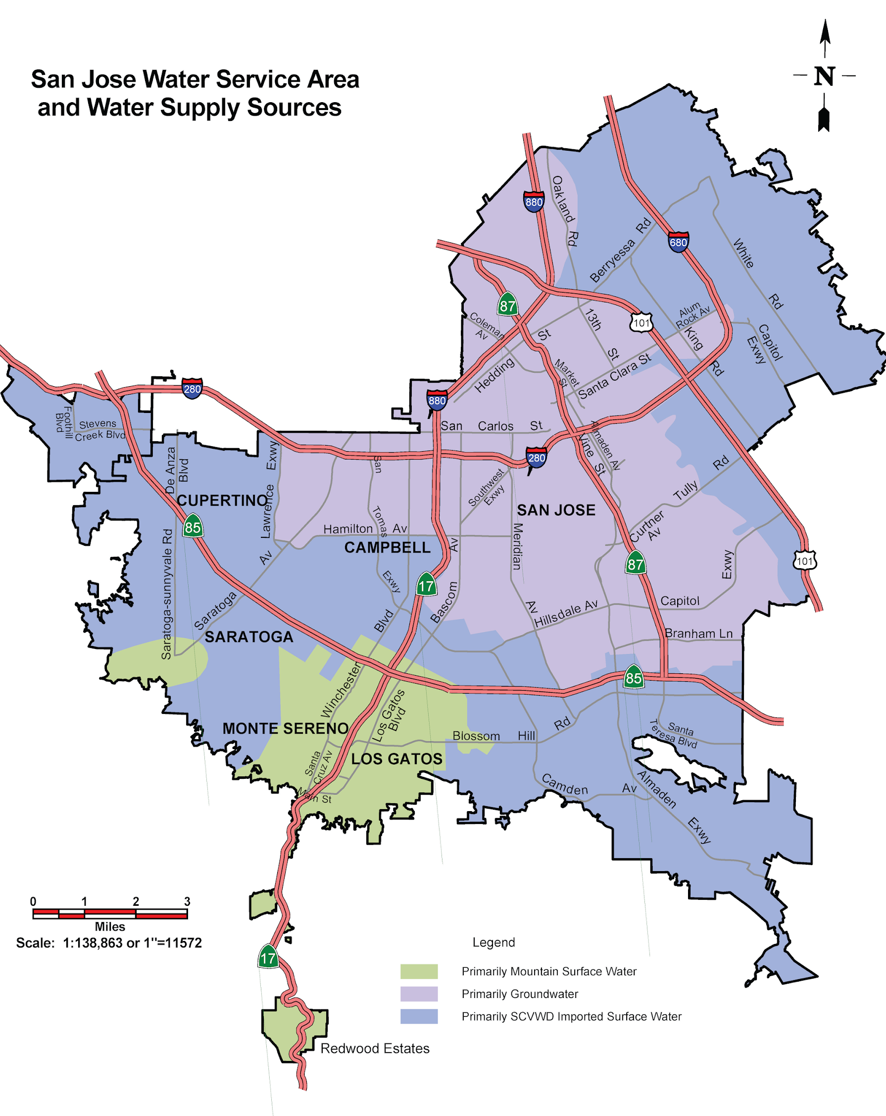
San Jose Water – Water Sources

Slide 5


Water: Who Does What?
Valley Water: Wholesaler
  Groundwater management agency
  10 Reservoirs in Santa Clara County
  3 Water Treatment Plants import water from the Sierras
  VW sells water to San Jose Water
San Jose Water: Retailer
  Treats water
  Delivers it to your home
  Provides customer service, ensures water quality, responds to emergencies
  Invests in and maintains water infrastructure (2,400 miles of main, 94 tanks)
Notes:
Groundwater - SJW pays pump fee, VW manages subsidence
SJW purchases treated water and pays fee

Slide 6
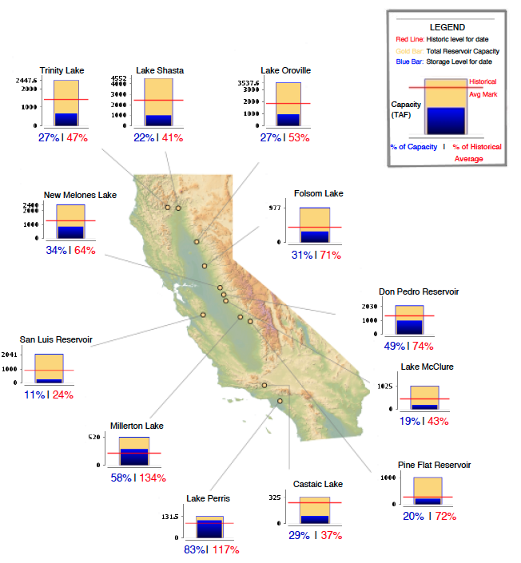
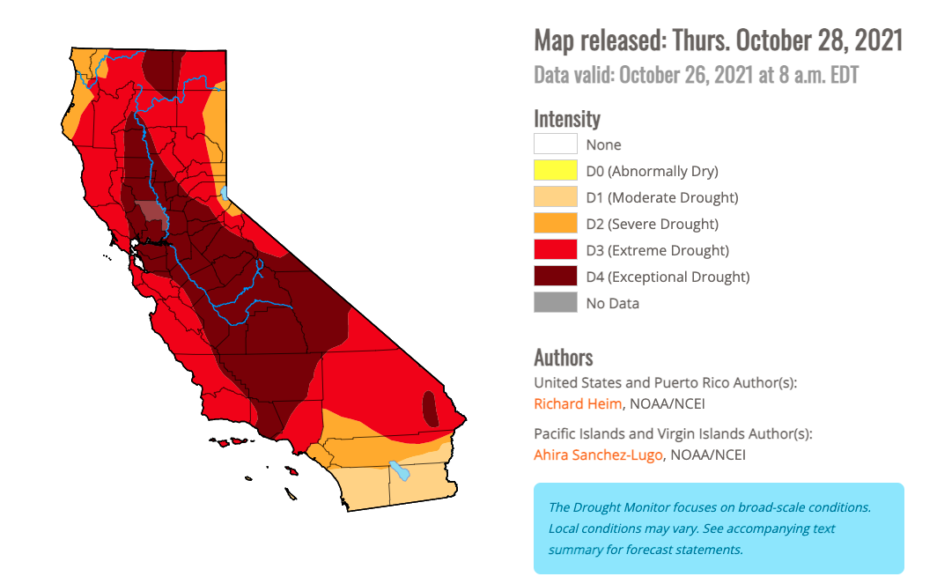
Current Reservoir Conditions & Drought Monitor
Current Conditions
Drought Monitor
Midnight: October 27, 2021
http://cdec.water.ca.gov/cgi-progs/products/rescond.pdf

Slide 7
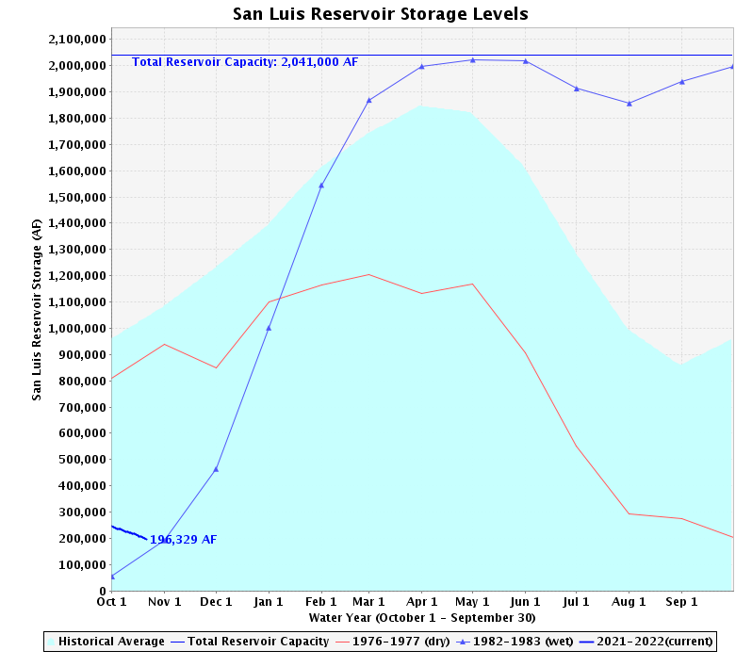
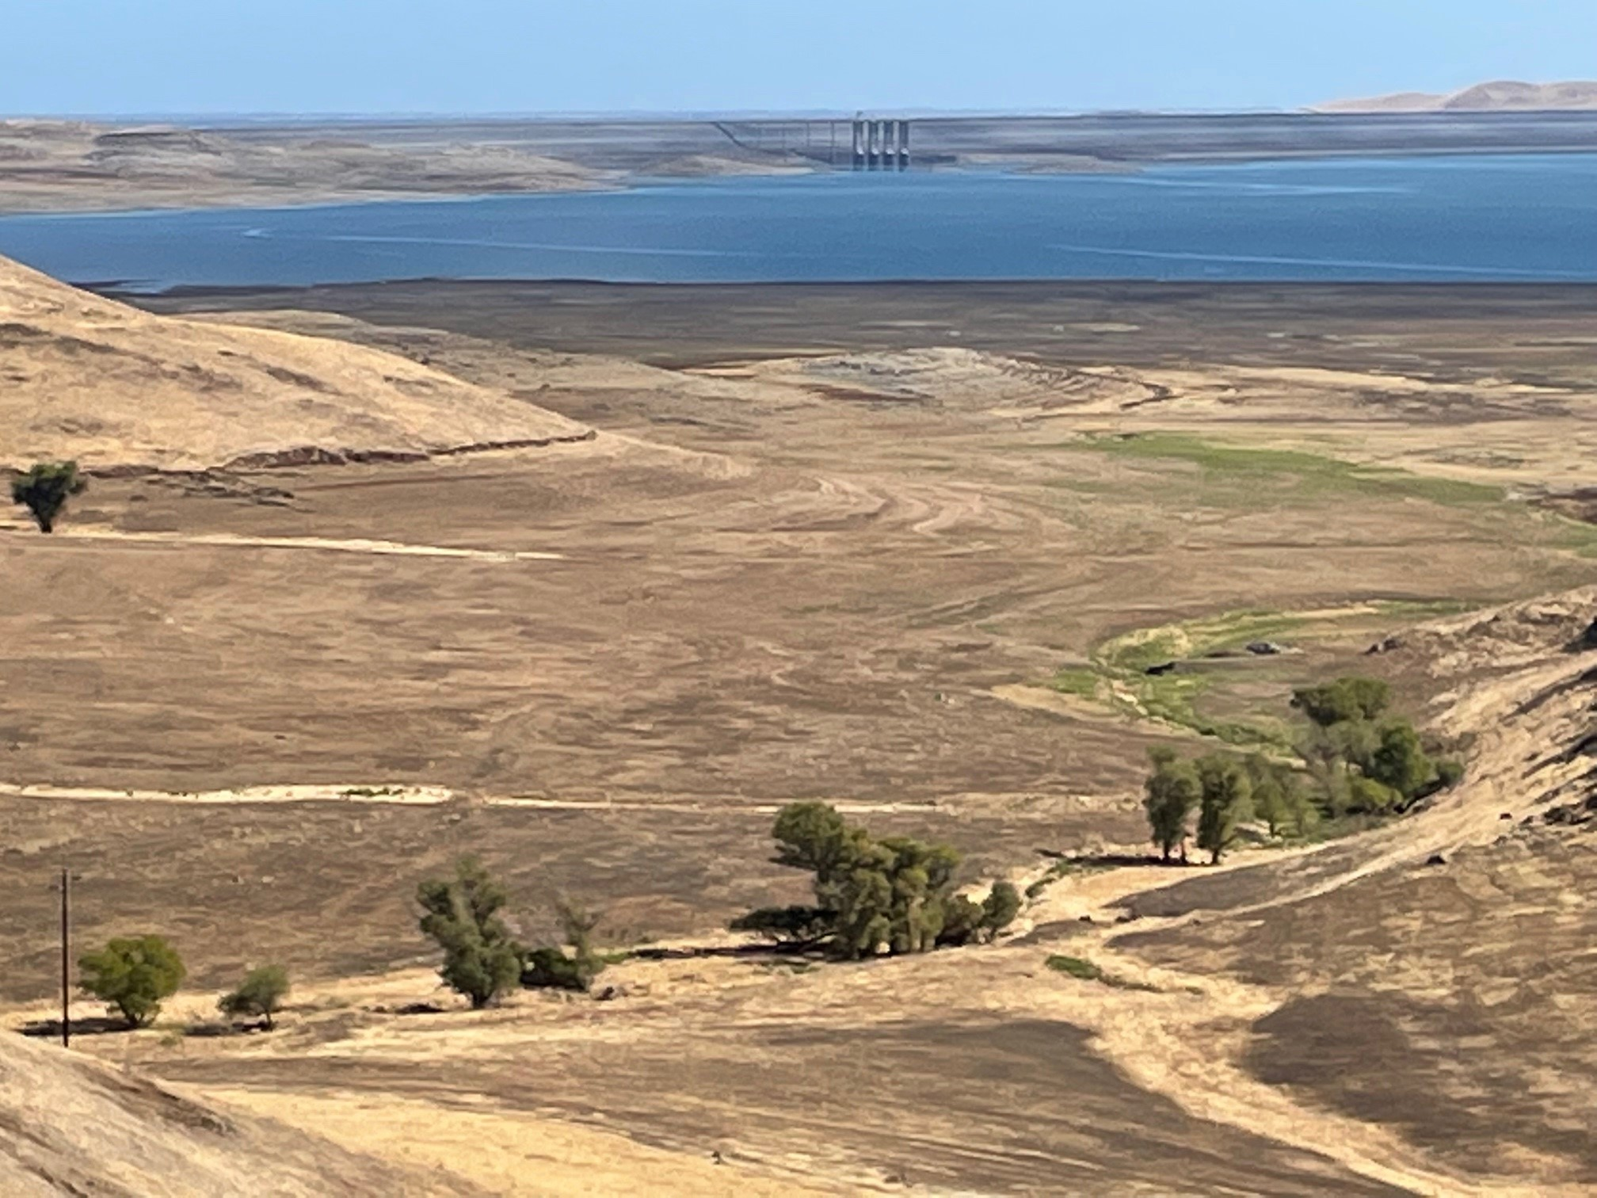
San Luis Reservoir Status

Slide 8

2021 Drought Update
June 9th : Valley Water calls for 15% conservation cutbacks from 2019 levels
July 8th : Governor Newsom calls for statewide conservation efforts
July 12th : Santa Clara County calls for drought emergency
SJW asks customers to reduce water usage by 15% from 2019 levels
Water use restrictions in place

Slide 9
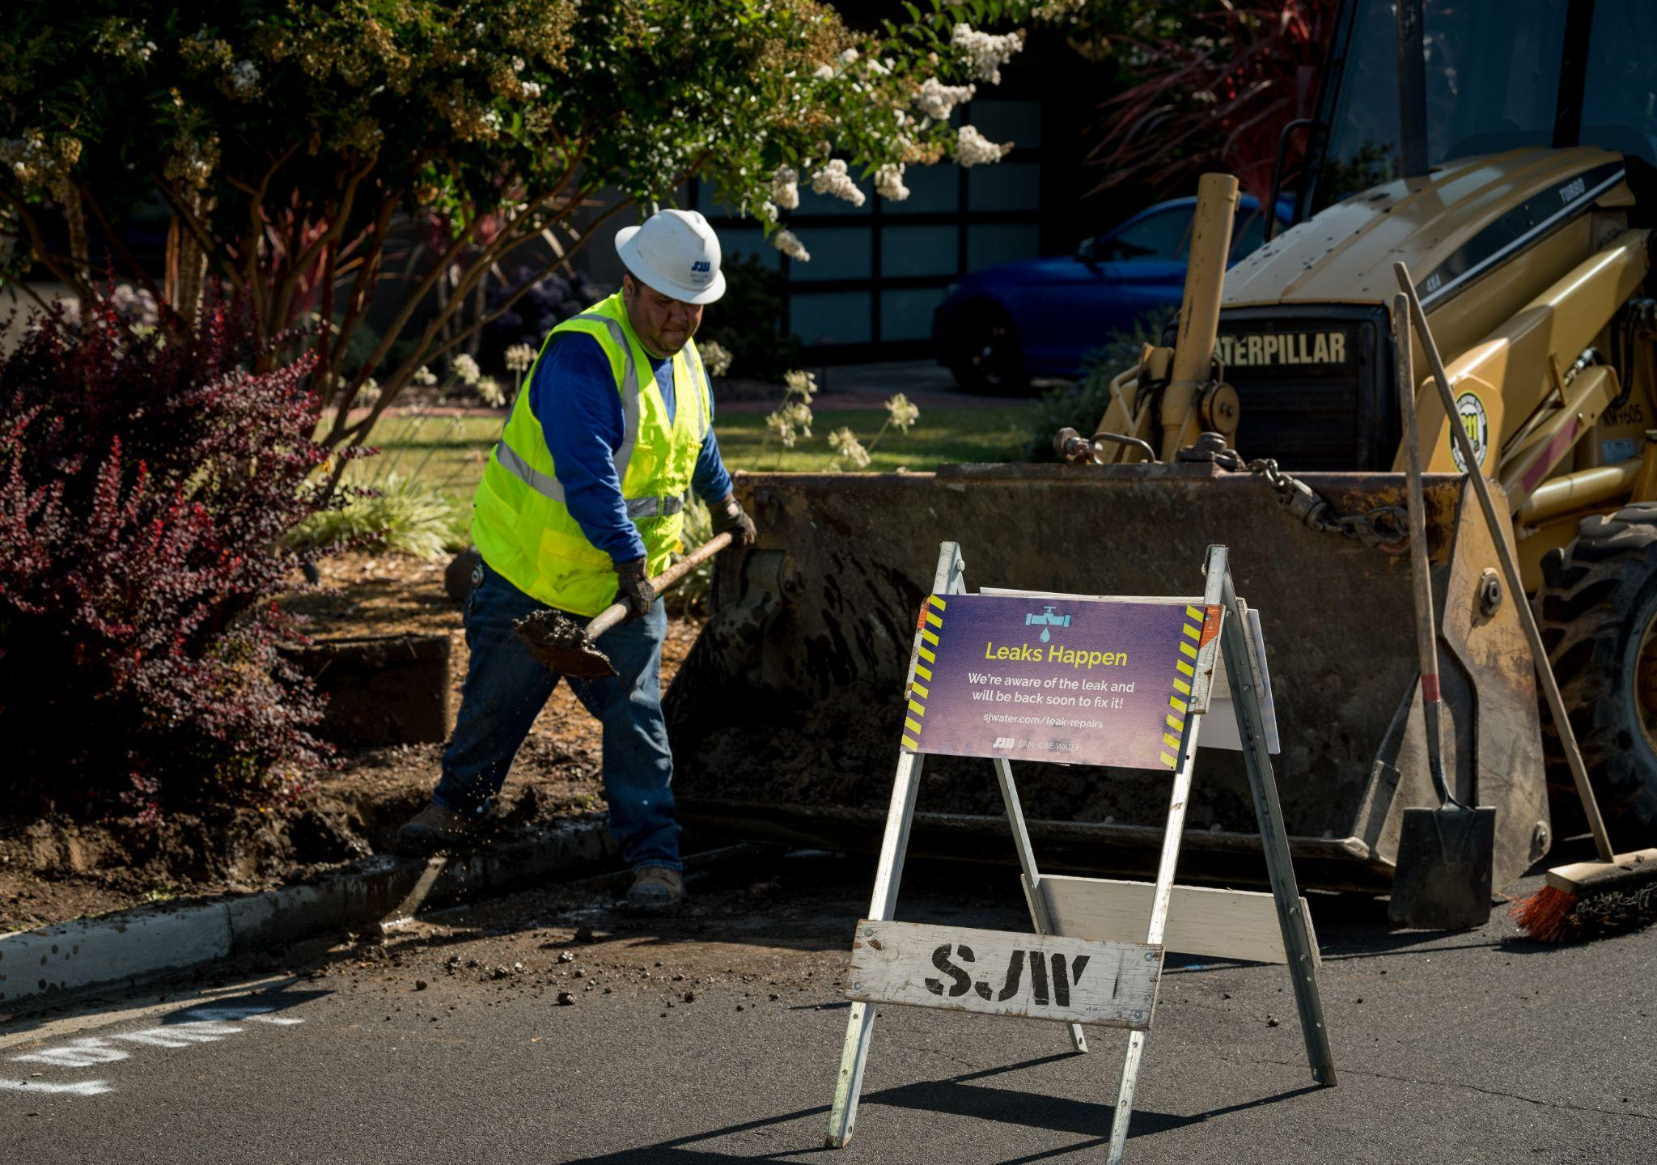
SJW’s New Mandatory Conservation Plan
Filed Schedule 14.1 Water Shortage Contingency Plan with California Public Utilities Commission
October 15th Filing
October 28th Public Hearing
CPUC Approval Pending
SJW Implementation

Slide 10

New Plan for a New Normal
2021 UPDATE
Three major components:
Water use allocations based on a
customer’s individual 2019 usage
A set of minimum allocations
to recognize the efforts of our
low water-using customers
Drought surcharges for exceeding
allocations
2019 Base Year
(Based on YOUR Usage)
Use > Allocations
= Drought Surcharges
Support For
Low Users
Notes:
This plan is different from the one used in the previous drought from 2015 - 2017. The current plan takes into account existing water supply conditions, Valley Water’s call for conservation, and lessons learned from the droughts in 2015 and in the early 1990’s. Emphasize this is based on individual usage.

Slide 11
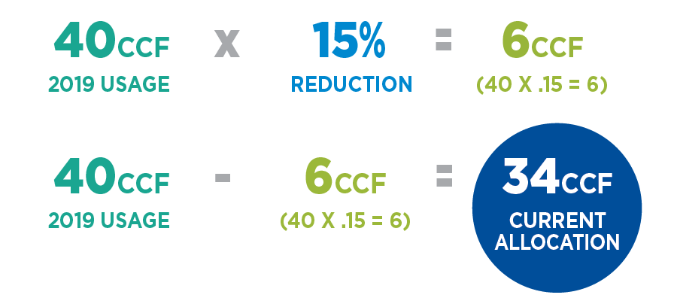



Allocations
Current call for 15% reduction in usage from your personal 2019 levels
Customers will have bi-monthly allocations printed on their bills
1CCF = 748 GALLONS
2 gallons per minute
1.6 gallons per flush
6 gallons per cycle
Notes:
All residential customers and landscape service accounts will receive a water use allocation based on their individual 2019 usage. NOT THE SAME PLAN AS THE LAST DROUGHT WHEN EVERYONE RECEIVED THE SAME ALLOCATION.
The current 15% can change over time. Increased or decreased levels of conservation may be required in the future depending on our water supply situation
and/or orders from the State or California Public Utilities Commission.
Customers who have very low usage and fall below the minimum drought allocations shown below will not be asked to cut usage back. This minimum allocation will protect
those users from drought surcharges.

Slide 12
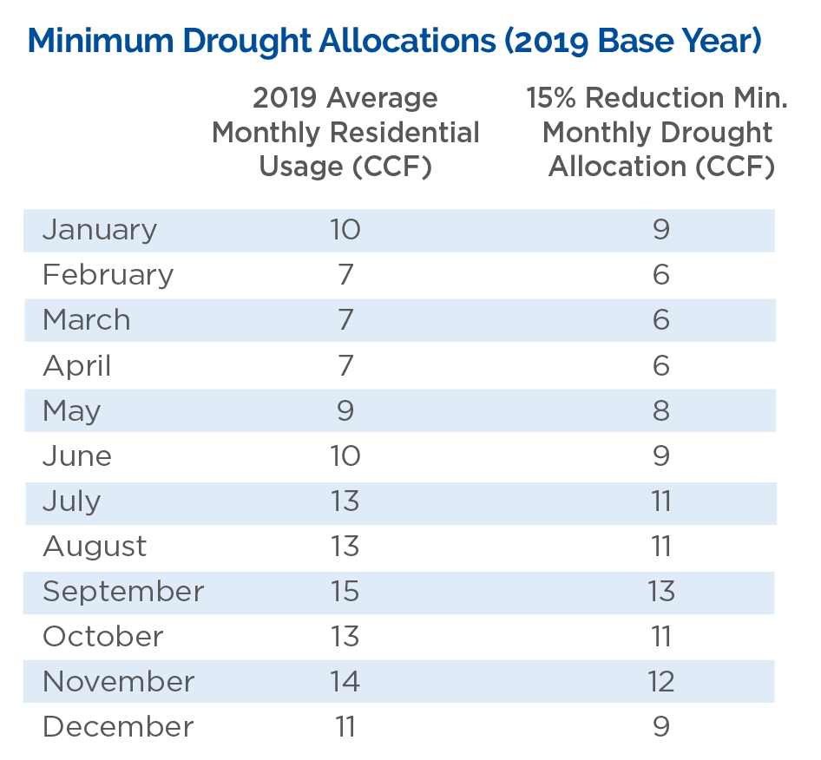
Allocations
Protecting low water users – no drought surcharges if usage is below minimum allocation.
Notes:
All residential customers and landscape service accounts will receive a water use allocation based on their individual 2019 usage. NOT THE SAME PLAN AS THE LAST DROUGHT WHEN EVERYONE RECEIVED THE SAME ALLOCATION.
The current 15% can change over time. Increased or decreased levels of conservation may be required in the future depending on our water supply situation
and/or orders from the State or California Public Utilities Commission.
Customers who have very low usage and fall below the minimum drought allocations shown below will not be asked to cut usage back. This minimum allocation will protect
those users from drought surcharges.

Slide 13
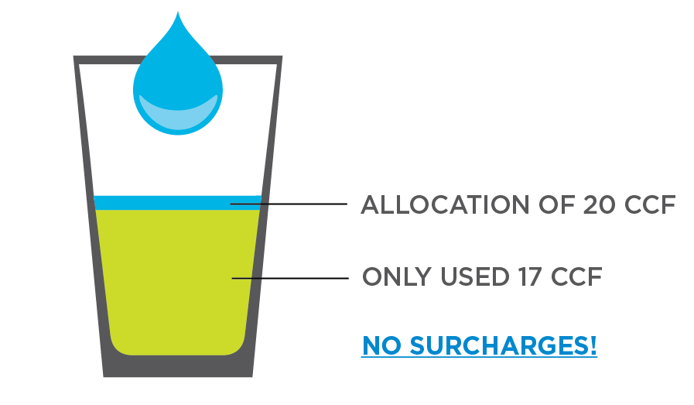
Drought Surcharges
Usage above the allocation is charged at Tier 3 rate – currently $7.13
Customers who exceed their allocations will incur drought surcharges in addition to the charges at the regular rates of water consumed.
CUSTOMER A
Has an allocation of 20 CCF of water for a two-month billing period.
Uses 17 CCF of water during that time.
No drought surcharges are applied to this bill because Customer A used less than the allocation.
Notes:
Effective ___(date)_____, customers who exceed their allocations will incur drought surcharges.
Any units of water above the monthly drought allocation will be charged at the Tier 3 rate in effect,
currently $7.13 per unit. This is in addition to charges at regular rates for all units of water consumed.
What is a CCF?
The most common units are centum cubic feet (CCF) and the gallon. A CCF also called an HCF
(hundred cubic feet), represents one hundred cubic feet of water. The first "C" comes from the Roman
word for hundred, "centum.” This is the most common unit used by both water and natural gas utilities.

Slide 14
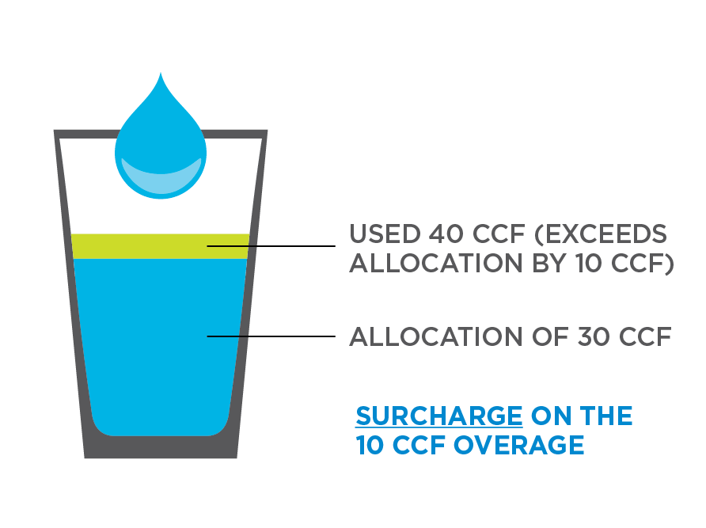
Drought Surcharges
Usage above the allocation is charged at Tier 3 rate – currently $7.13
Customers who exceed their allocations will incur drought surcharges in addition to the charges at the regular rates of water consumed.
CUSTOMER B
Has an allocation of 30 CCF of water for a two-month billing period.
Uses 40 CCF of water during that time.
Exceeds the allocation by 10 CCF (40-30).
In addition to paying for the 40 CCF of water, the customer is charged a drought surcharge of $71.30 (Tier 3 rate x units over the allocation = 7.13 x 10 CCF of water).
Notes:
Effective ___(date)_____, customers who exceed their allocations will incur drought surcharges.
Any units of water above the monthly drought allocation will be charged at the Tier 3 rate in effect,
currently $7.13 per unit. This is in addition to charges at regular rates for all units of water consumed.
What is a CCF?
The most common units are centum cubic feet (CCF) and the gallon. A CCF also called an HCF
(hundred cubic feet), represents one hundred cubic feet of water. The first "C" comes from the Roman
word for hundred, "centum.” This is the most common unit used by both water and natural gas utilities.

Slide 15
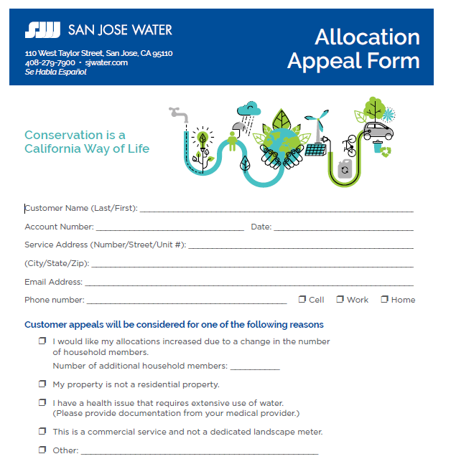
Appeals
If you think your allocation needs to be changed, we will review your appeal
Submit the appeal form for review
Common reasons for appeals
  # of people in the home
  Health issue
Notes:
Get the URL for the appeal form. Fillable PDF. Then mail to us. We can also mail you a copy if you prefer.
If you don’t think your allocation is appropriate, you can appeal to the CPUC.

Slide 16



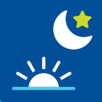

Water Use Rules
Water only 2 days per week
Limit filling of decorative fountains and ornamental lakes/ponds
Water no more than 15 minutes per day
Water in the very early morning or late evening
Wash cars at a commercial car washing facility that recycles water

Slide 17
Top Questions
What if my allocation needs adjustment because my situation has changed since 2019?
1
2
I have a medical condition that requires water. What about my allocation?
3
Does all the recent heavy rain mean the drought is over?
4
Why is building continuing in the area during a drought?
5
Why are you using 2019 as the base year for water reductions?
6
Why are we paying more and more for less and less water?
7
What about desalination? Recycled water?
8
What about Smart Meters?
Notes:
Tricia Q1-2
Kurt Q3-4
John Q5-9
Question #3 - John/Kurt - From Colby - the recent rains has not significantly changed Lake Elsman’s levels. It went from 10% to 12% full. Not enough to end the drought.

Slide 18

Questions?
More drought information can be found at:
www.sjwater.com/drought
www.beheard.valleywater.org
www.sjwater.com/CATCH

Slide 19
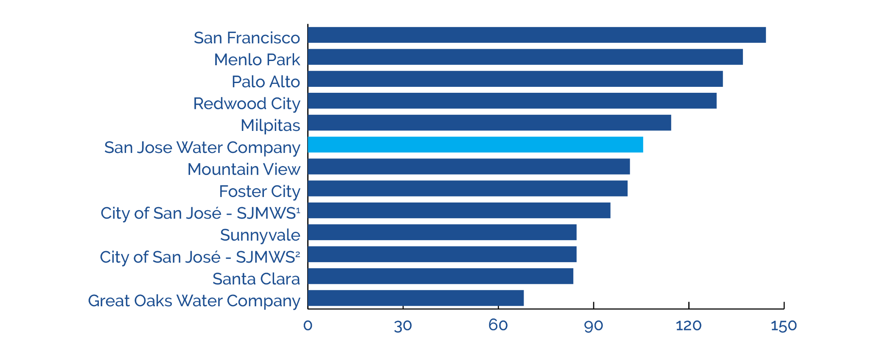
Rate Comparison
Source: City of San José – Jan. 2021
¹Represents monthly bill for customer in North San José/Alviso service area.
²Represents monthly bill for customer in North Evergreen/Edenvale-Zone 1 area.

